Slide 1

Web AppBuilder for ArcGIS: Knowing Your Options - 2019 Spring Workshop

Slide 2
What is the Web Appbuilder for ArcGIS?
An ArcGIS Framework that allows one to create HTML/JavaScript Apps that run on desktops, tablets, and smartphones
The software allows you create applications without any coding……Even though you can create even cooler apps if you know how to code with the Developers edition
Has built in/ready-to-use widgets and themes to choose from
Allows one to deploy a WAB app on ArcGIS Online or on web server
Built in responsive design (display adjust based on device used)
Requires ArcGIS Online or Portal for ArcGIS
The framework is integrated with WebMaps

Slide 3
2 Options to Work With Web AppBuilder
Within ArcGIS Online or Portal for ArcGIS
Framework embedded in the web site
Activate in AGOL and Portal from Multiple places
Developer Edition
Separate download and installed locally
Sign in with ArcGIS Online or Portal for ArcGIS credentials
Support for custom widgets and themes
System requirements
https://developers.arcgis.com/web-appbuilder/guide/xt-system-requirements.htm

Slide 4

How Can It Help You Create Applications?
I will attempt to show you

Slide 5

But First…….You need to know the fundamental parts (If you don’t already know them)

Slide 6
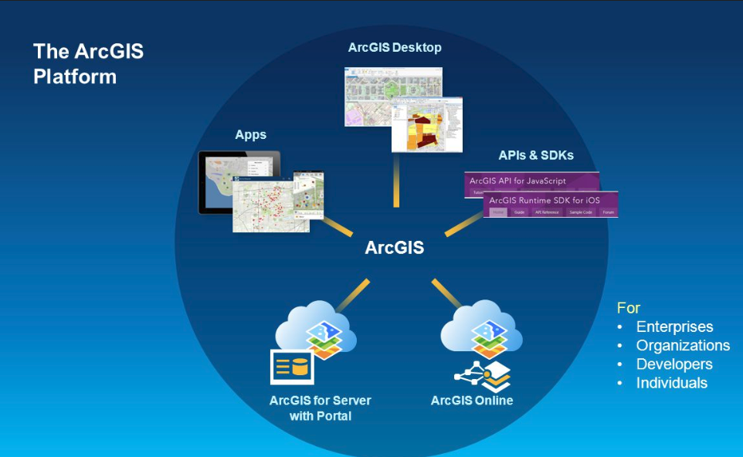
The Platform (image by Esri)

Slide 7
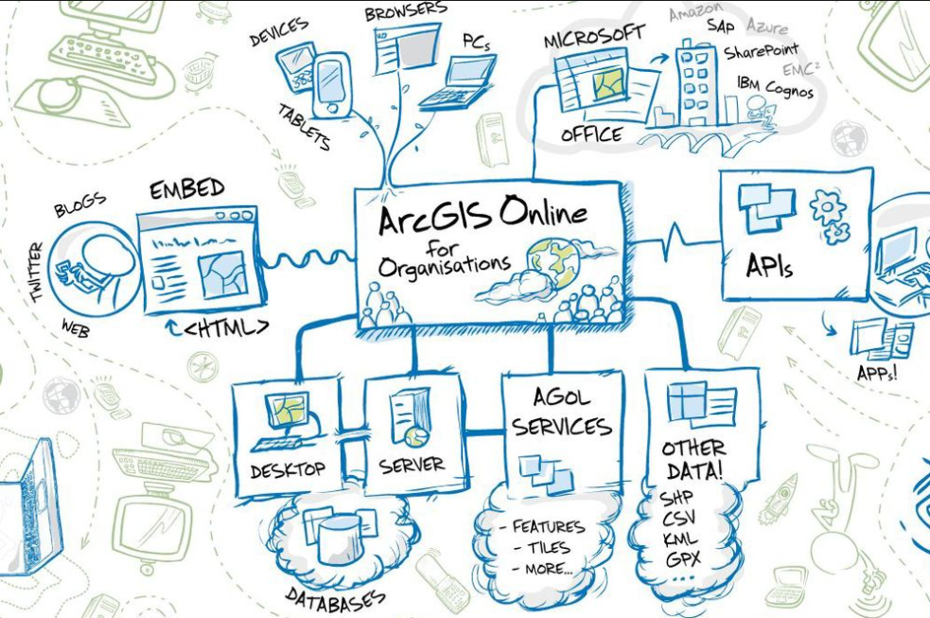
The Platform (image by Roket Science)

Slide 8
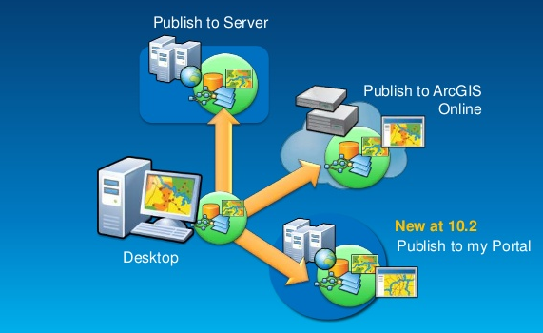
Create and/or Publish GIS Data

Slide 9
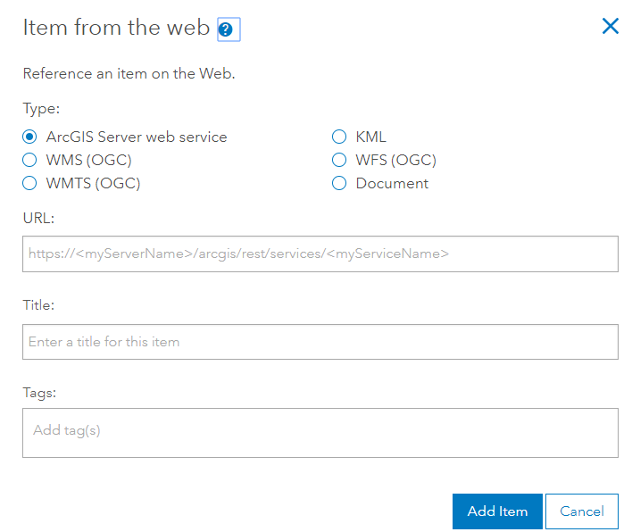
OR Consume services……. - hosted services (layers published to AGOL) Types: Feature layers, Tile layers, Vector tile layers, scene layers (3d), and more - consumed services - services that are stored in a ArcGIS for Server REST directory or other compatible directory that are accessed by AGOL or Portal and stored as a AGOL/Portal configuration

Slide 10
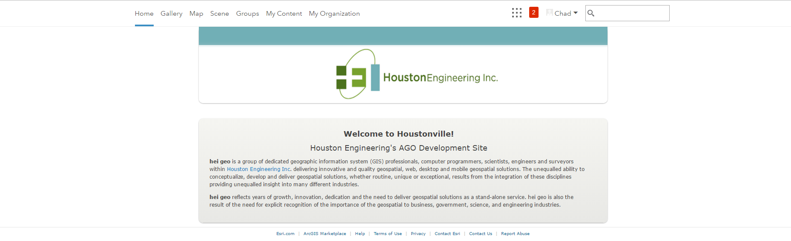
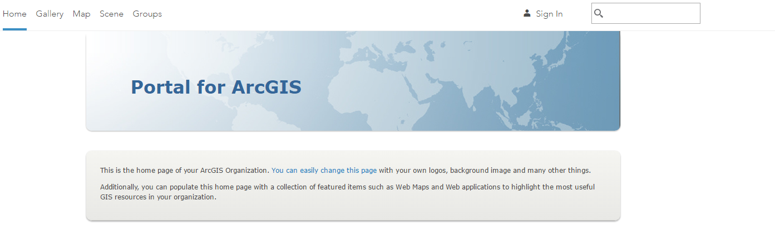
Create a web Map – Portal or ArcGIS Online

Slide 11
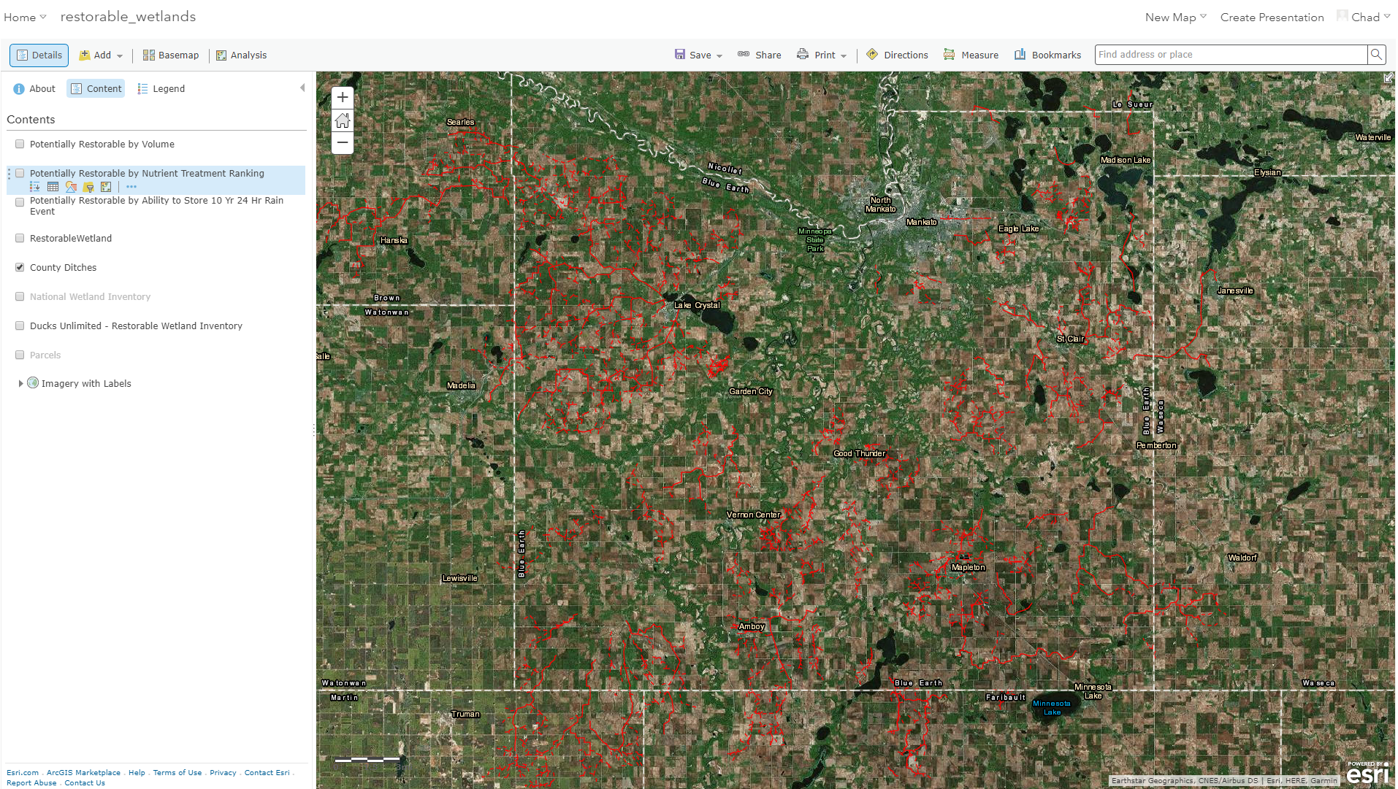
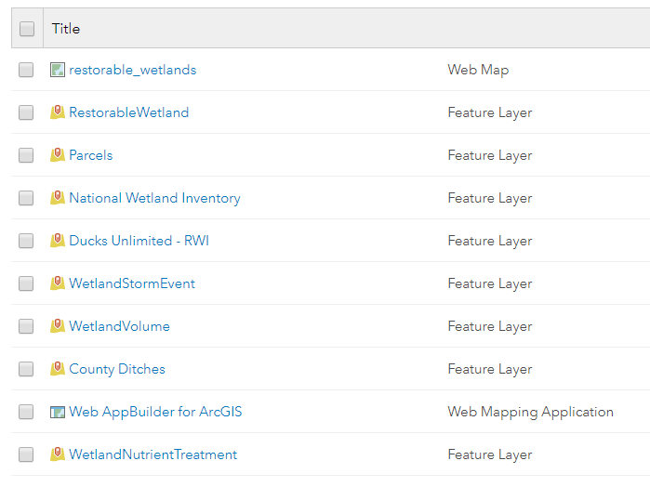
Configure, Share, and Save the web map

Slide 12
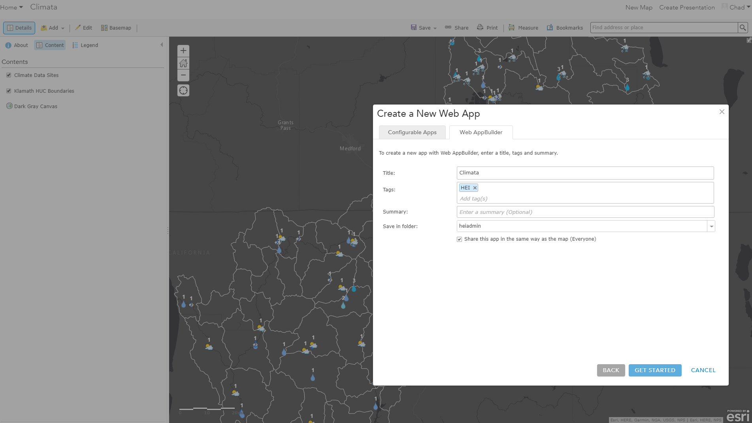
Create a Web AppBuilder App from your web map in Portal for ArcGIS or ArcGIS Online – Same Process!

Slide 13
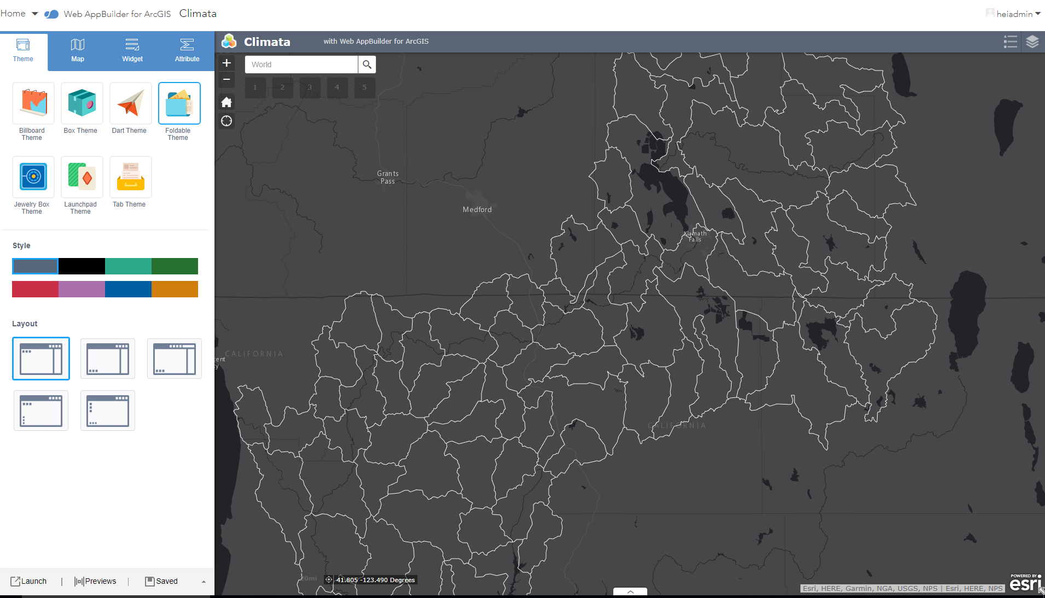
Configure your app. Pick a theme and all out-of-the-box widget you want. Save Note: The step can also be done in the WAB Developer Version

Slide 14
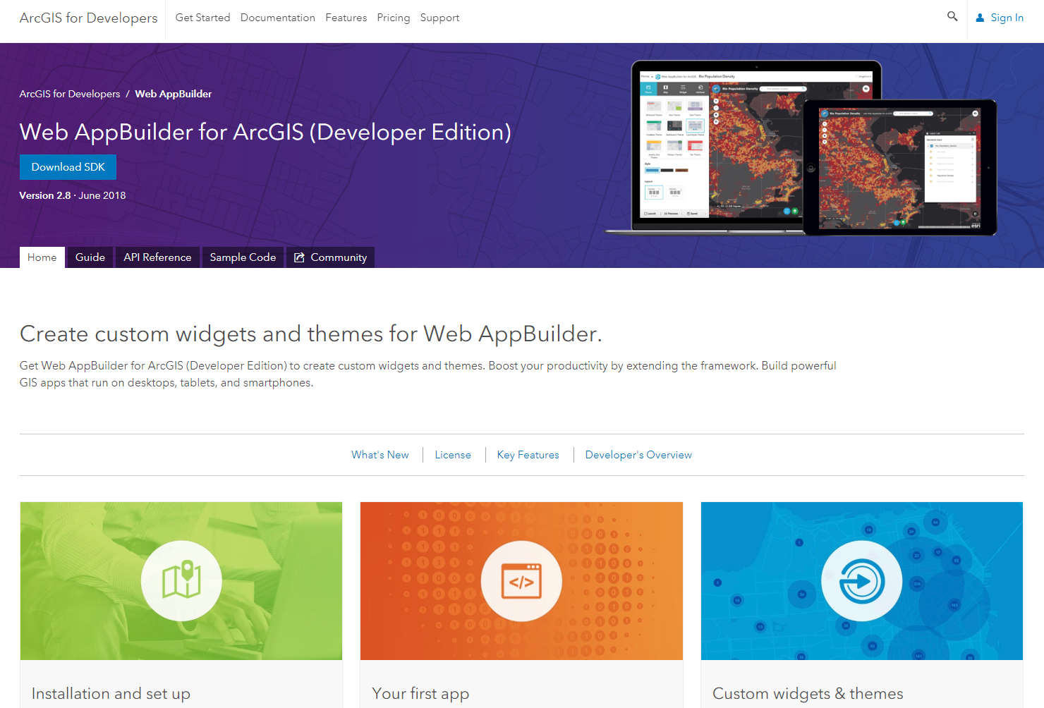
Getting Ready to Roll with the Developers Versions of the WAB……Download the Software

Slide 15
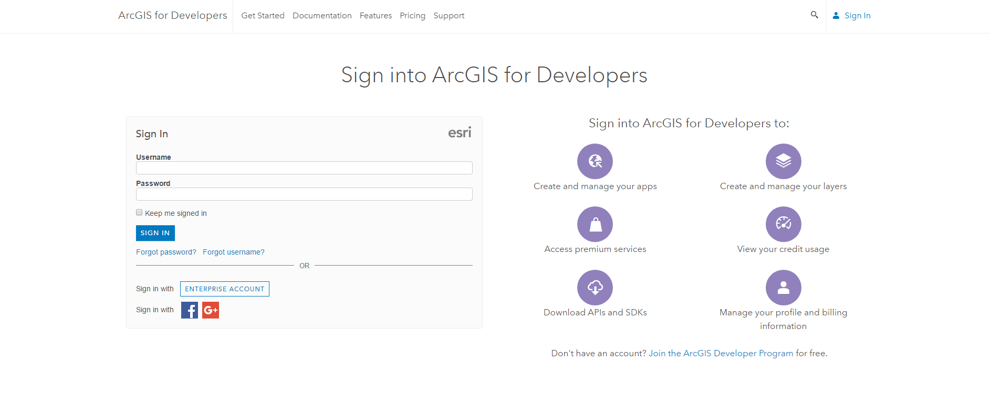
Sign In before you Download

Slide 16
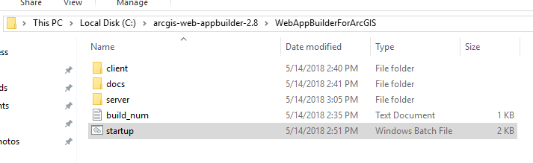
Extract Downloaded Zipfile to Desired Location

Slide 17
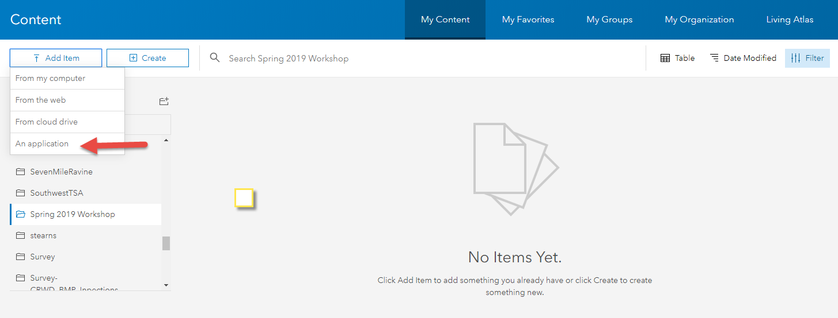
Register WAB Dev Edition w/ AGOL or Portal

Slide 18
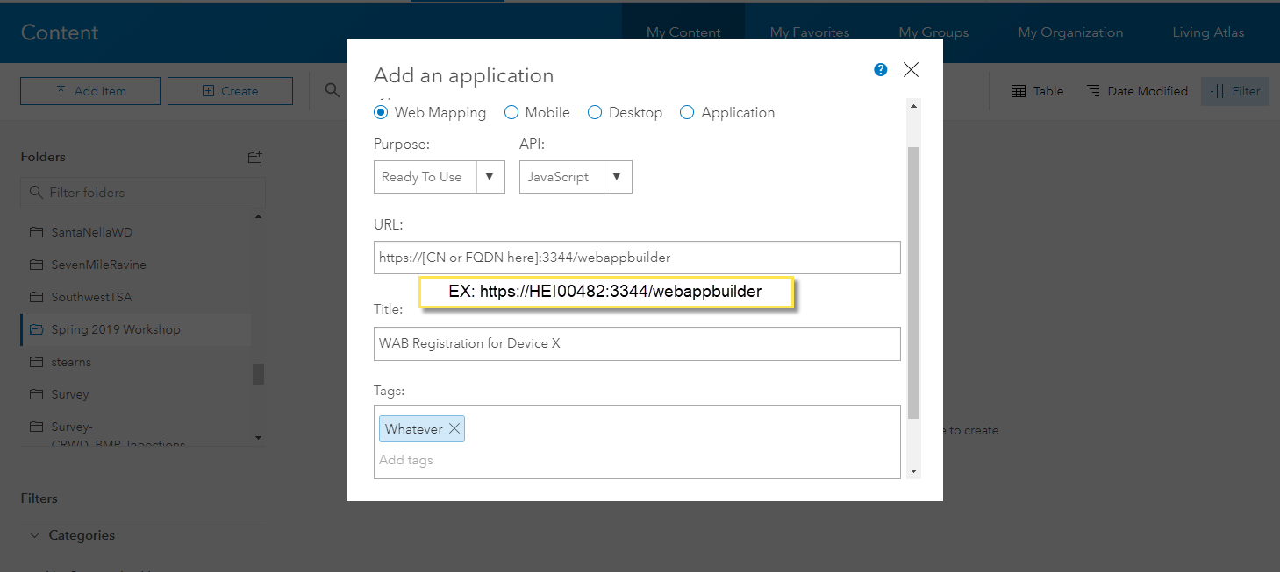
Create Application in AGOL or Portal

Slide 19
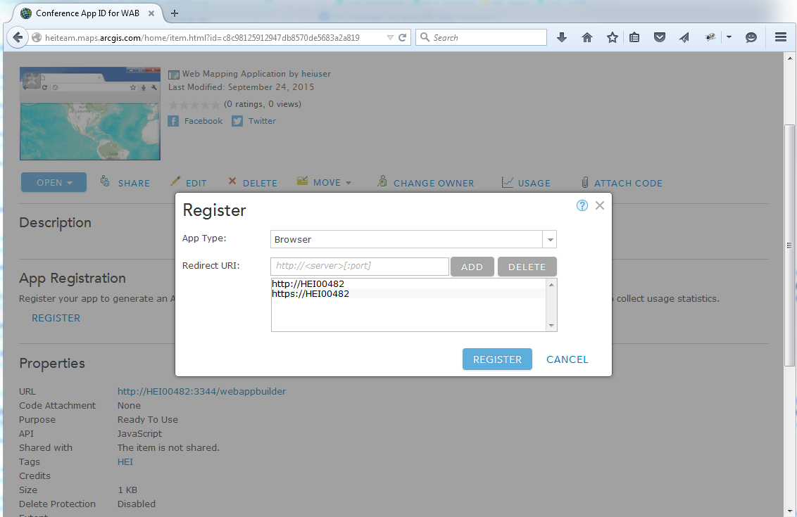
Register Application

Slide 20
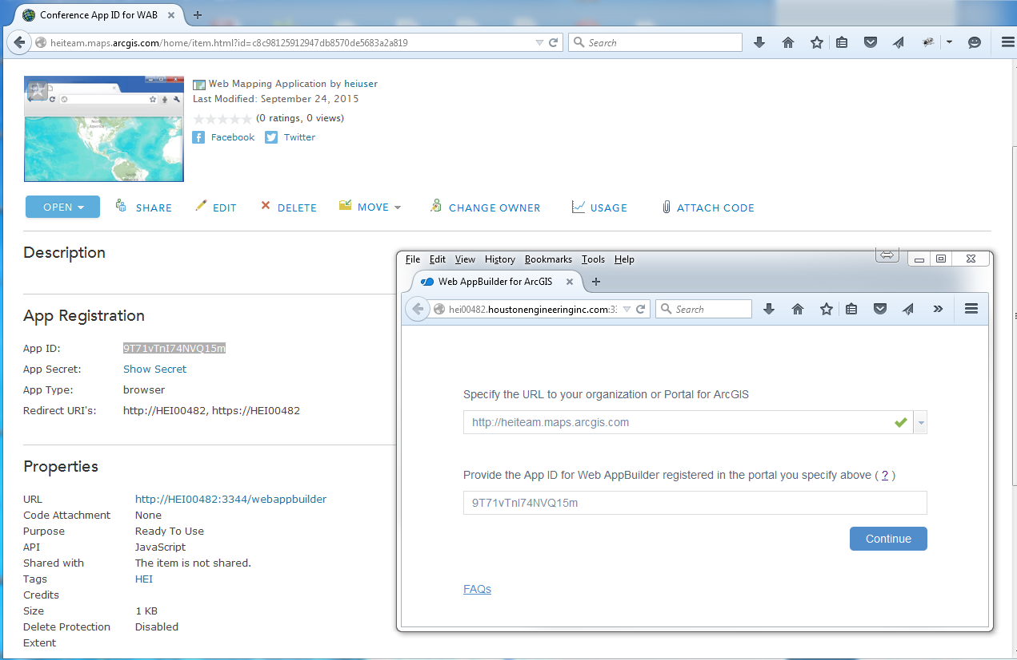
Add AP ID (and Portal URL) to WAB Dev Edition

Slide 21
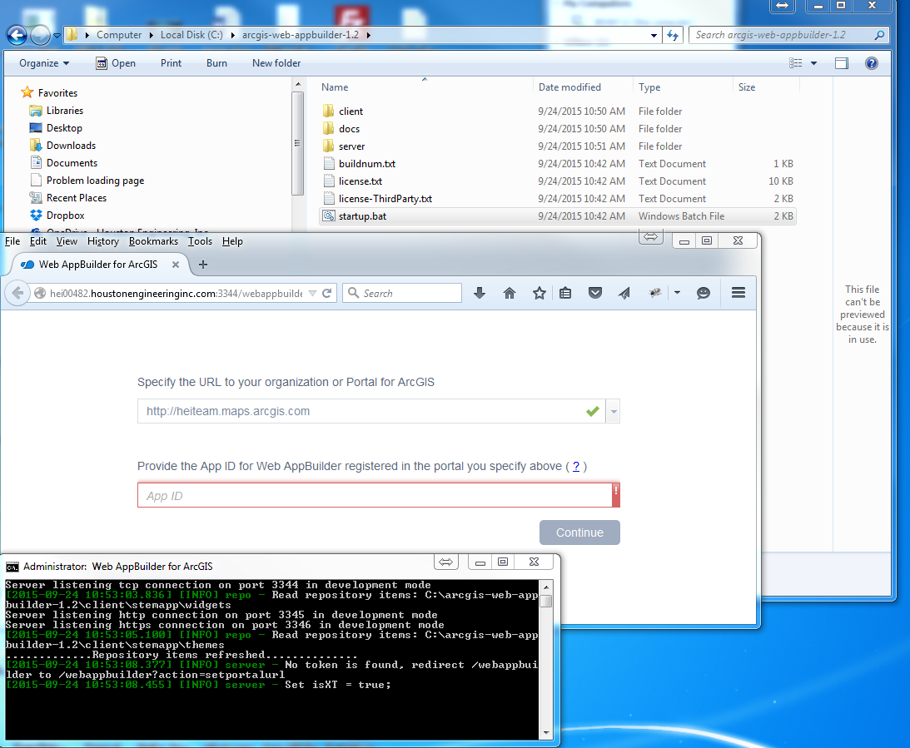
Launch App and add AGOL URL and App ID

Slide 22

Invalid Redirect_URI message……WT????????....No Worries….Not a Big Deal

Slide 23
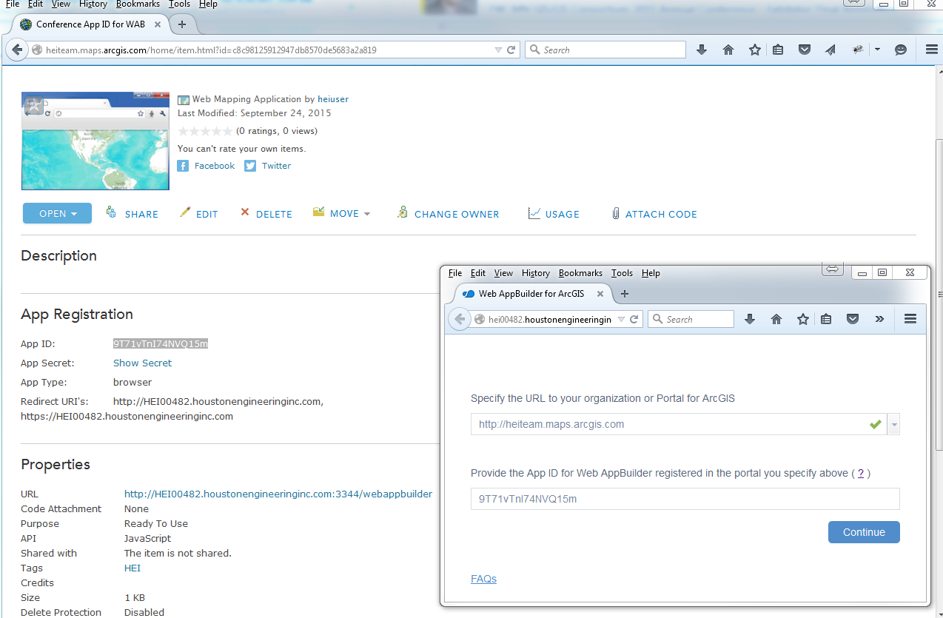
Figure Out Why….In My Case, the full computer name wasn’t used the first go-round. Update App Registration, delete singininfo.json, and try again

Slide 24
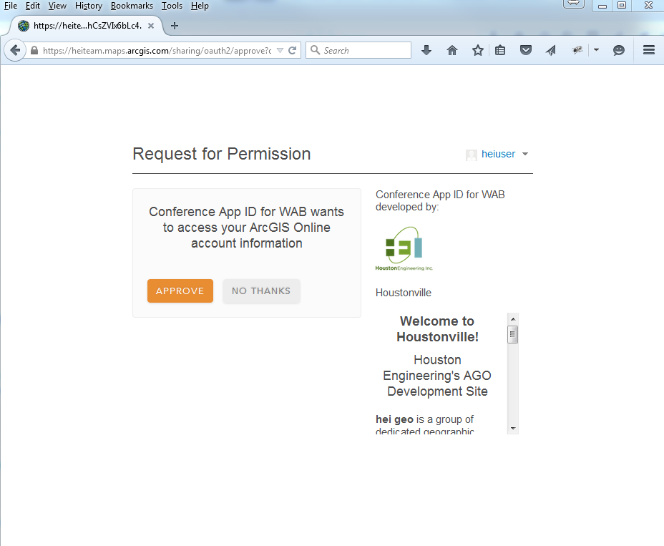
New AppId Worked!!!....Now just give permission

Slide 25
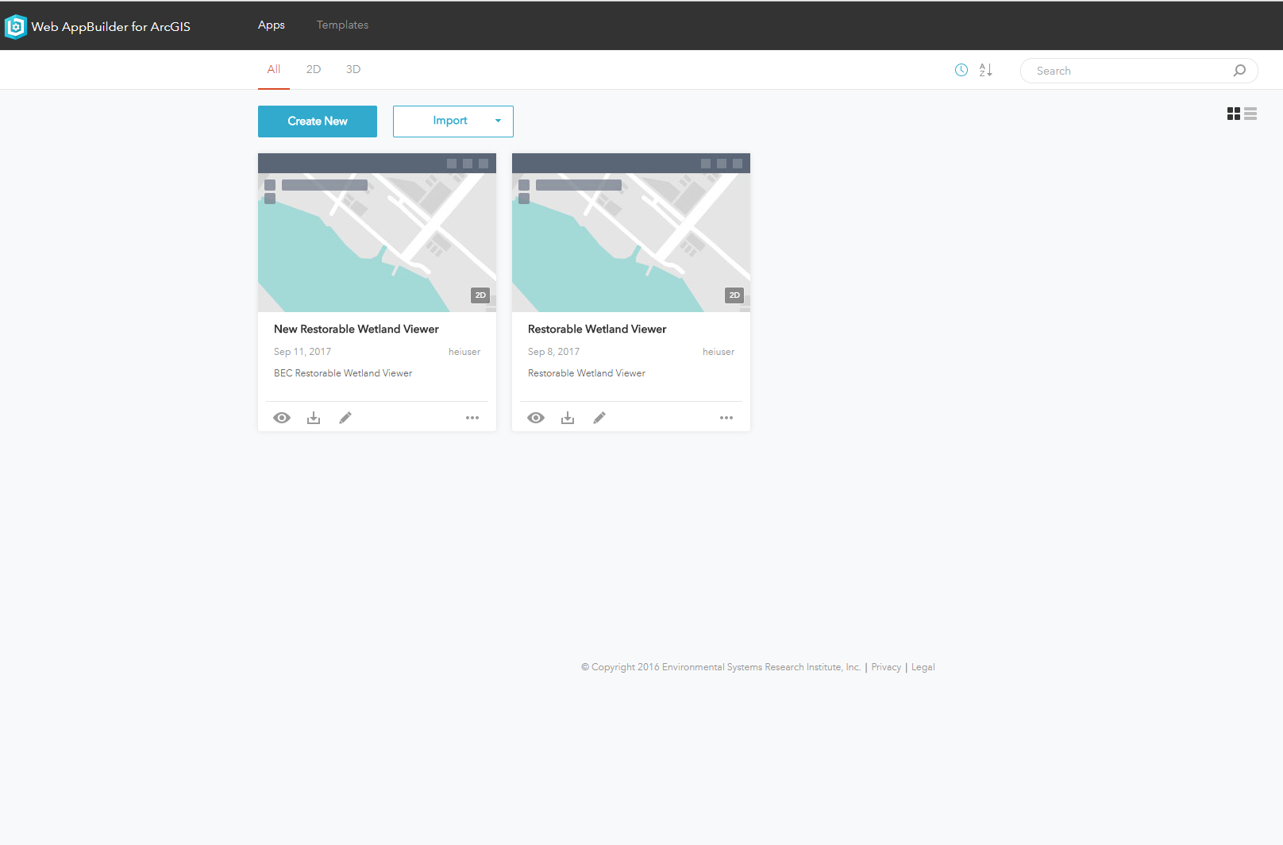
Create New OR Import (Account or Computer)

Slide 26
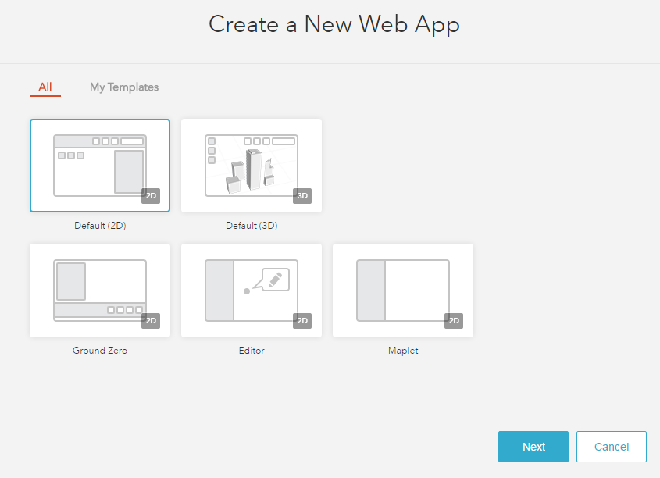
Create New - Select Template

Slide 27
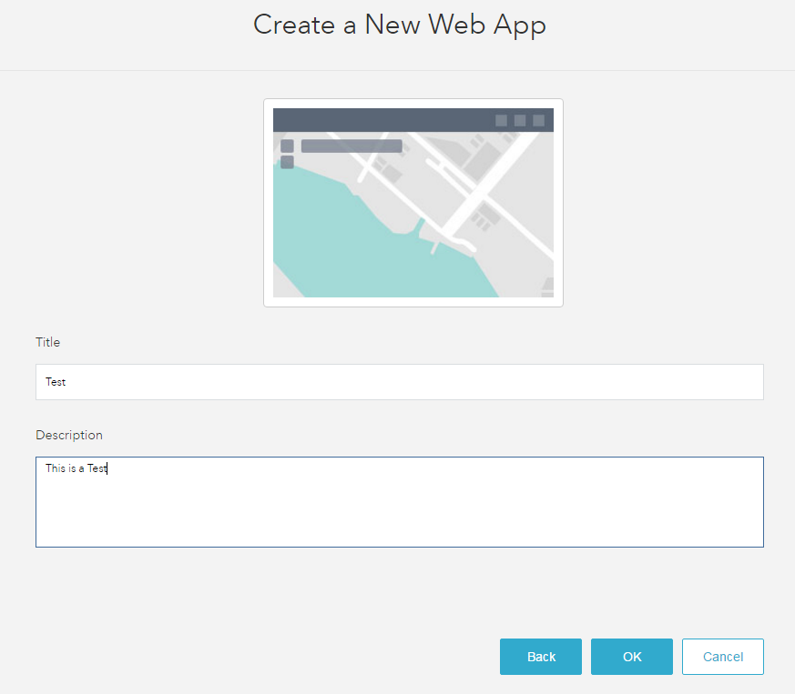
Create New - Give It A Name

Slide 28
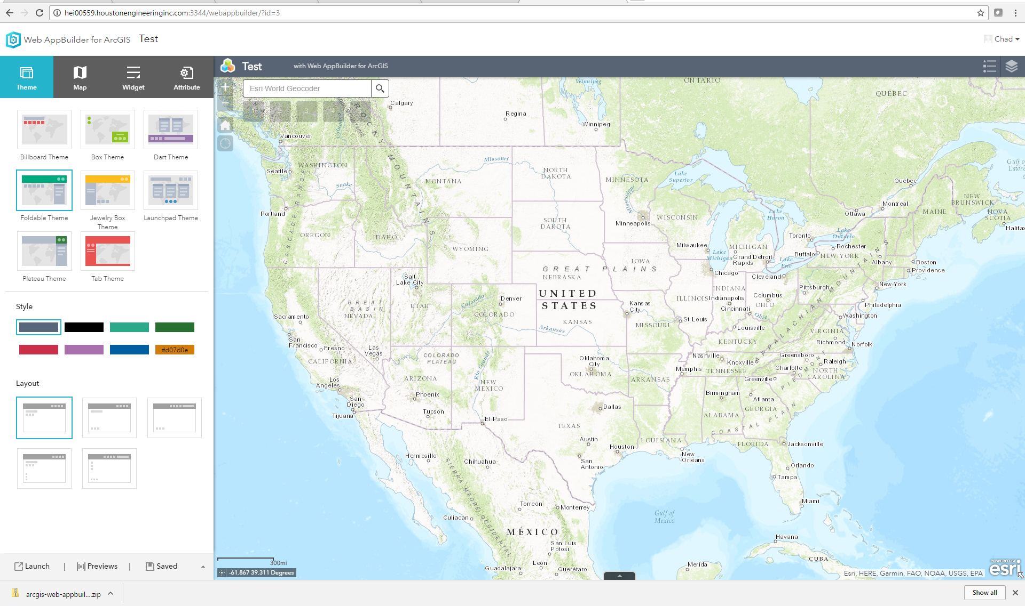
Create and/or configure application with the WAB Developer Edition (Note: Non-custom WAB App configuration can be accomplished via the Developer Edition OR in the AGOL version and then imported)

Slide 29
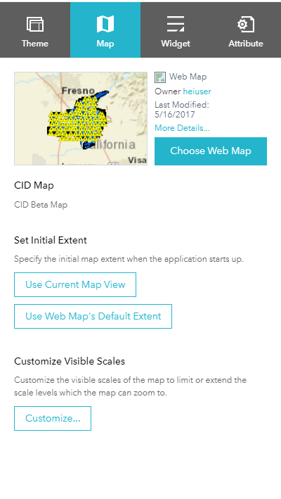
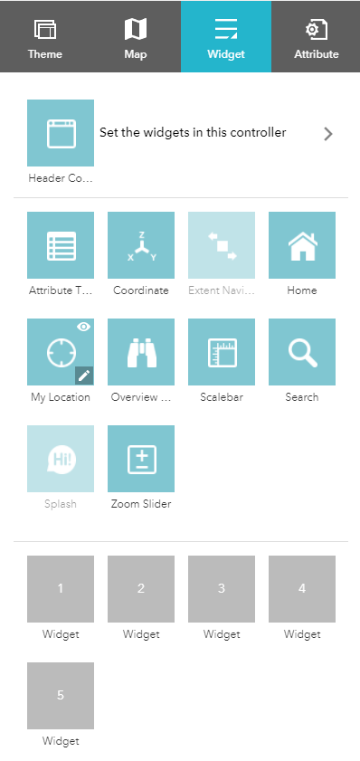
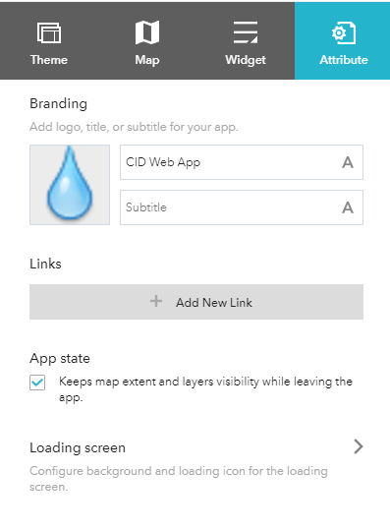
Create and/or configure application with the WAB Developer Edition (Note: Non-custom WAB App configuration can be accomplished via the Developer Edition OR in the AGOL version and then imported)

Slide 30
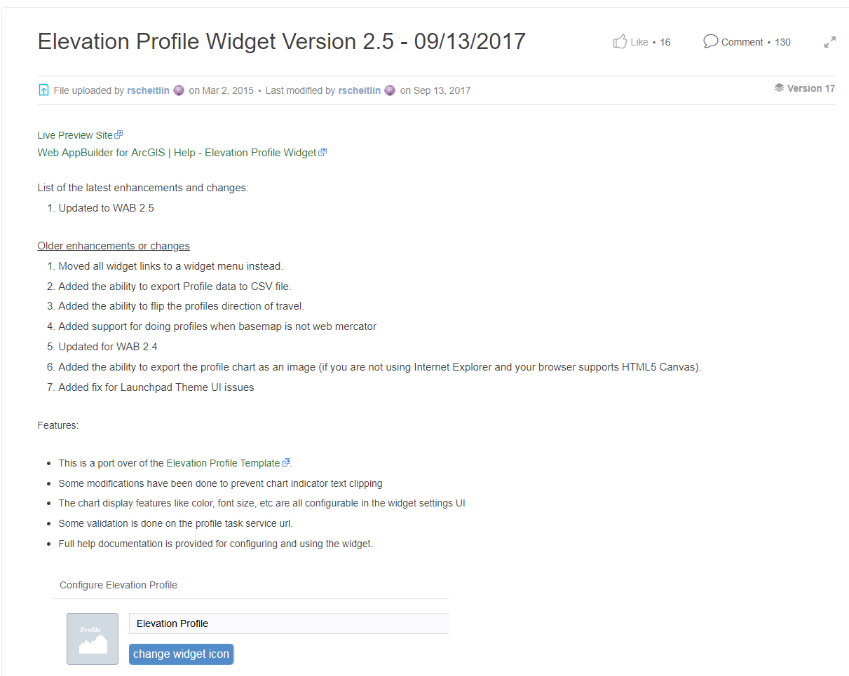
Adding A custom Widget From GitHub or Elsewhere https://community.esri.com/docs/DOC-3342-elevation-profile-widget-version-23-02142017

Slide 31
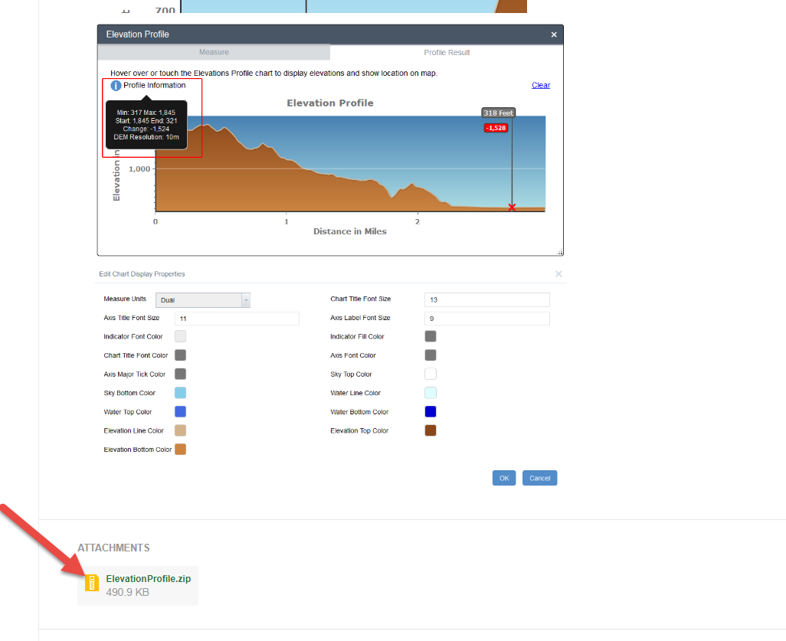
Download It(Make sure you out of the developer version of the WAB and have closed out of the command window as well)

Slide 32
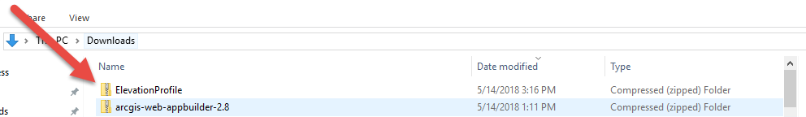
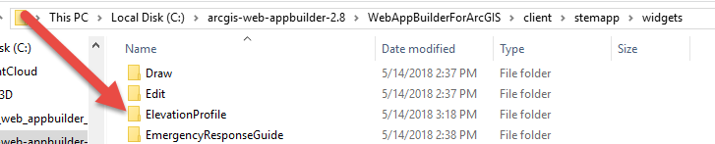
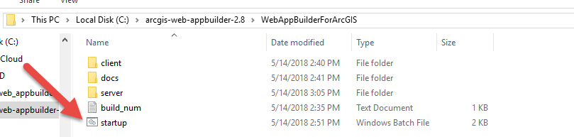
Extract It and Restart It(Make sure you out of the developer version of the WAB and have closed out of the command window as well)

Slide 33
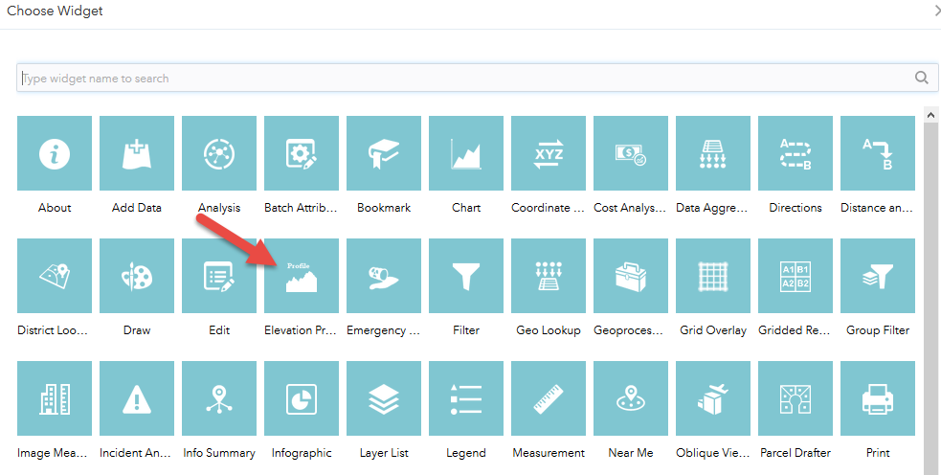
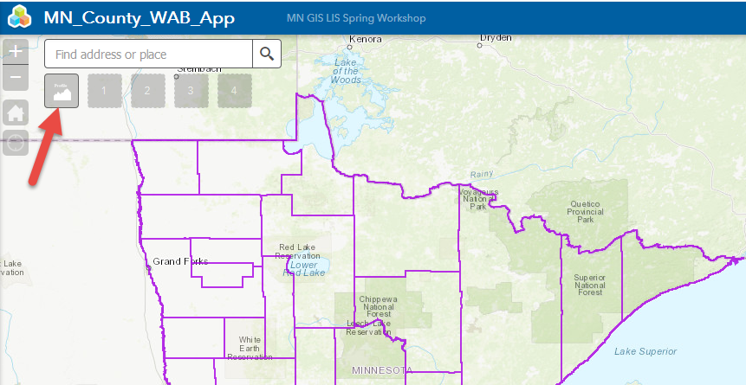
Load it and Use it

Slide 34
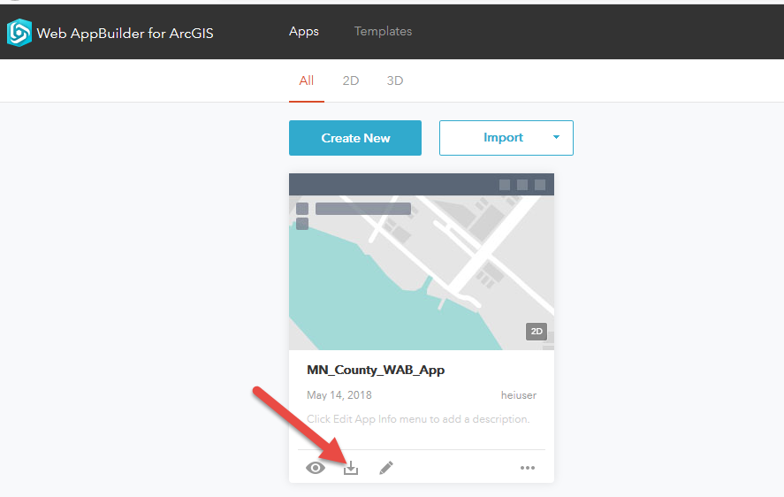
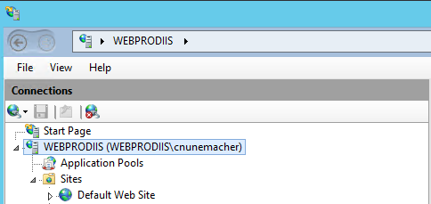
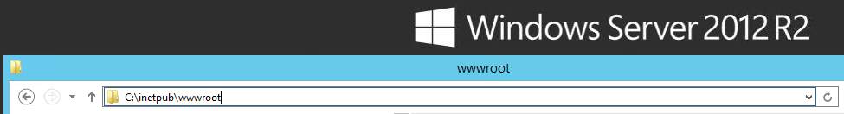
Deployment (Download, Move, and Deploy)

Slide 35
Paul Takes Over

Slide 36

Now On To That Coding Stuff …

Slide 37
Developer Edition – First Steps - Review
Download Developer Edition Files
Start .BAT batch file
Register App ID
Create a new Web Map

Slide 38

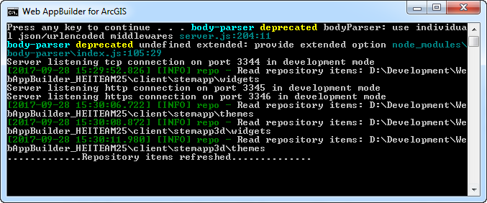
WAB – (Developer Edition) - Overview
Released – Dec. 2014
Leverages ArcGIS API for JavaScript (same back end libraries)
Can add custom widgets and themes
Node.js

Slide 39


WAB Development – Technical Stuff Needed
HTML5/JavaScript/CSS
DOJO Framework
JIMU (Rich SDK) - Chinese for Legos
Configuration in JSON

Slide 40

Let’s Back Track – What is JavaScript???
ECMAScript 5 or 6
ECMAScript 2015,2016,2017,2018
jQuery
Dojo
TypeScript
React/Angular

Slide 41
Wait … What is the ArcGIS JavaScript API ???
ESRI JavaScript library to create custom web maps
For advanced site designing and customizations
Not as many restrictions
Does not require ArcGIS Online or Portal connection
Does not require Web Map and can work directly with services.
Existed before Web AppBuilder framework was created

Slide 42

Widgets
Do you know you can also create widgets in ArcGIS API for JavaScript as well!!
Confused??

Slide 43

3.X vs 4.x
Currently all 2D WAB development is on 3.X. All 3D development is done in WAB on 4.X.
Parity between 3.X/4.X versions has been achieved as of 2019
Within a year or two 3.x will be cut off and all support will be on 4.x only.

Slide 44
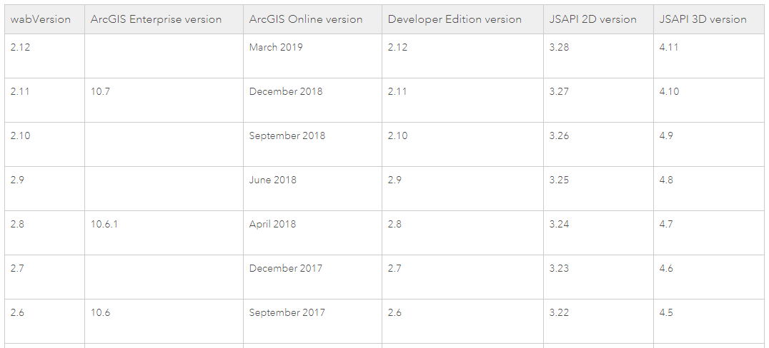
3.X vs 4.x

Slide 45
Widgets
Main use case for developers in Web AppBuilder
50 + widgets available in the default stemapp
Can buy in the ESRI Marketplace
Additional Widgets
Robert Scheitlin:
https://geonet.esri.com/thread/119278-roberts-custom-wab-widgets
Other Sources:
https://github.com/Esri/solutions-webappbuilder-widgets
https://github.com/Esri/WAB-Image-Services-Widgets
https://geonet.esri.com/groups/web-app-builder-custom-widgets
http://codesharing.arcgis.com/

Slide 46
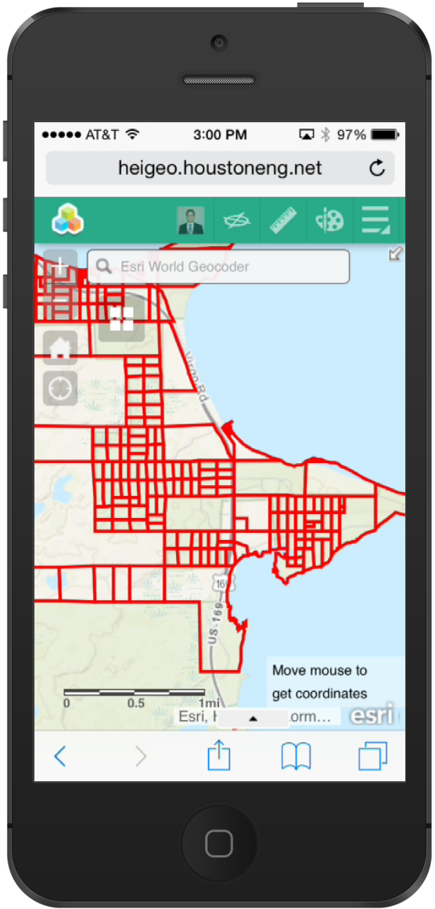
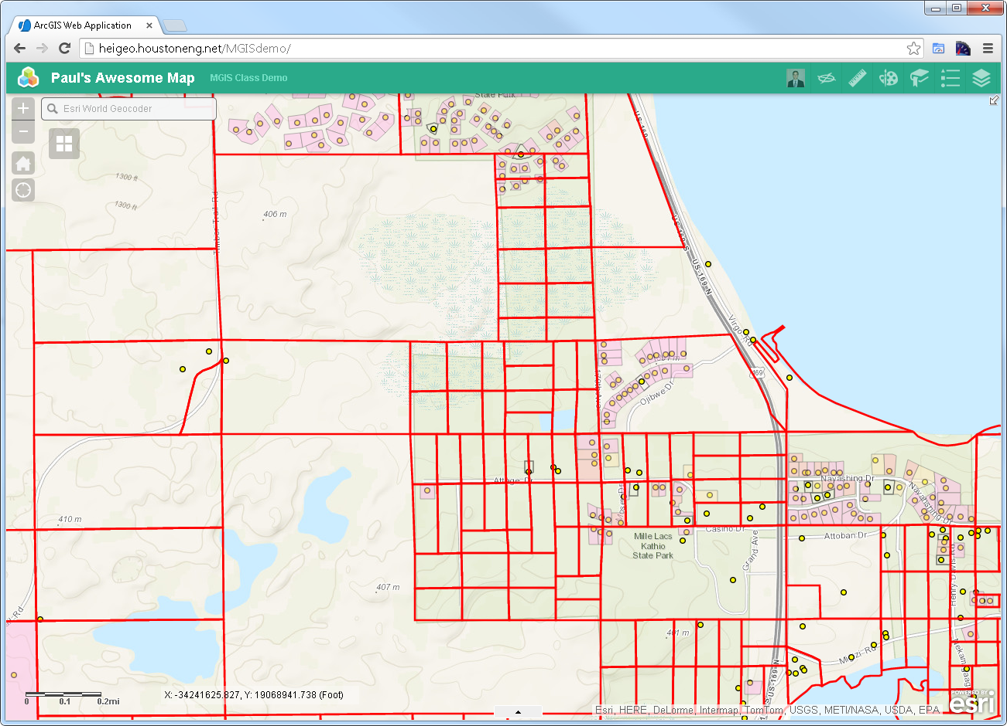
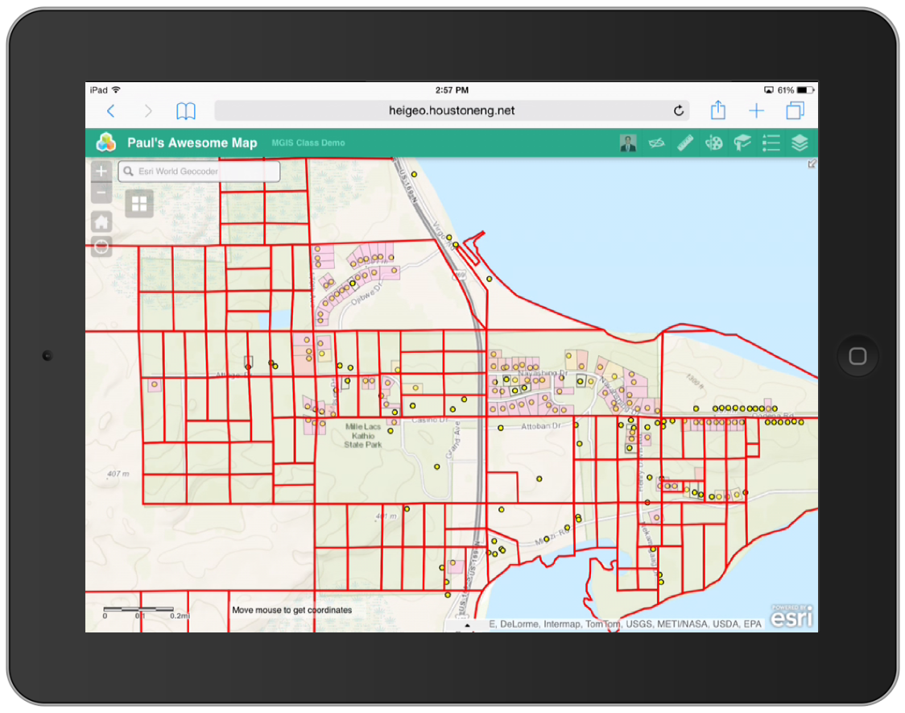
WAB – Responsive Design

Slide 47

WAB - Works on most devices

Slide 48

WAB - Not this one

Slide 49

WAB – Creating Custom Widgets

Slide 50
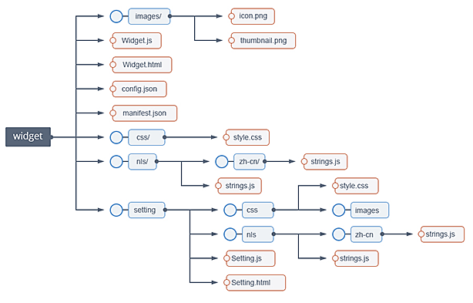
Custom Widget – File Structure
https://github.com/Esri/generator-esri-appbuilder-js

Slide 51
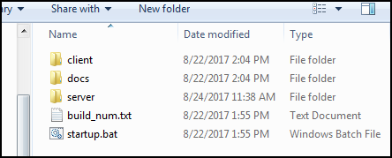
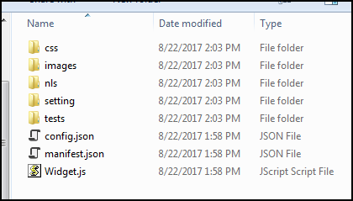
Widget Files …
WebAppBuilder\client\stemapp\widgets\{MyWidget}

Slide 52
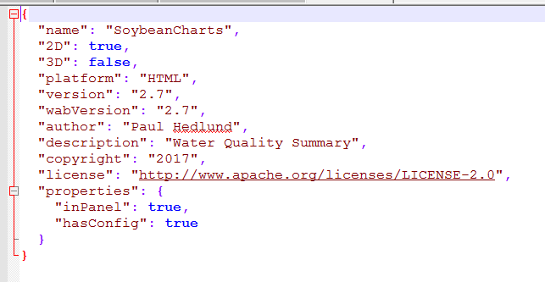
Manifest.json

Slide 53

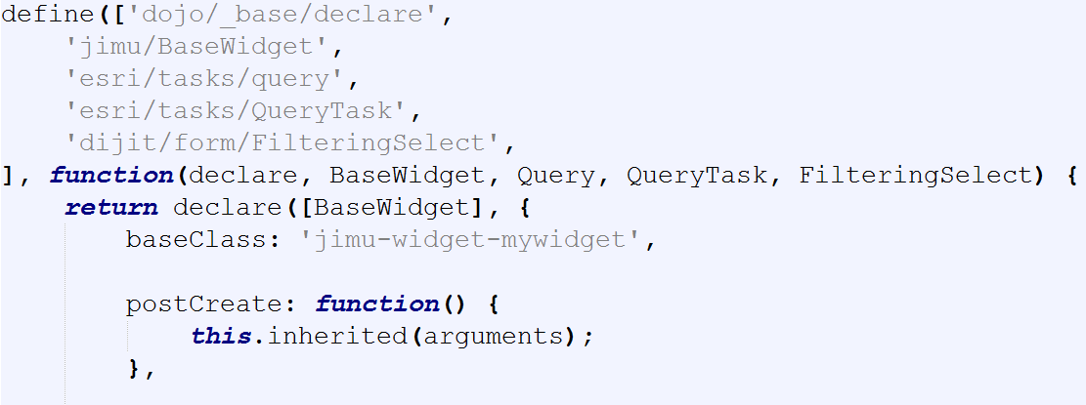
Custom Widget – Widget.js

Slide 54
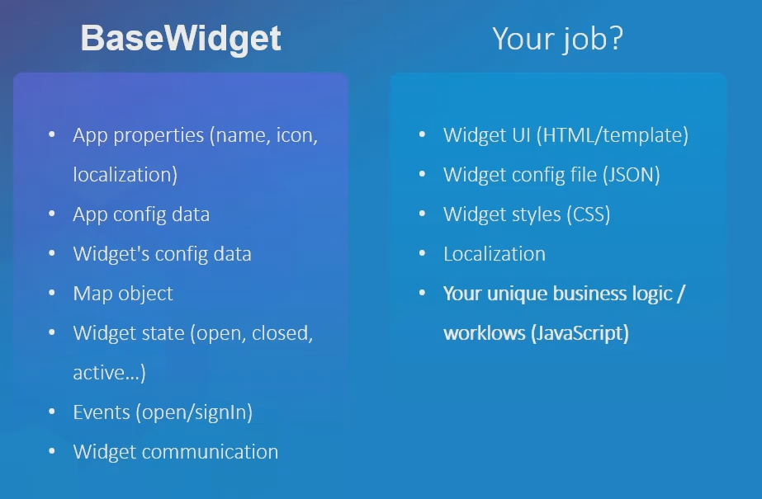
WAB – Extend Base Widget

Slide 55
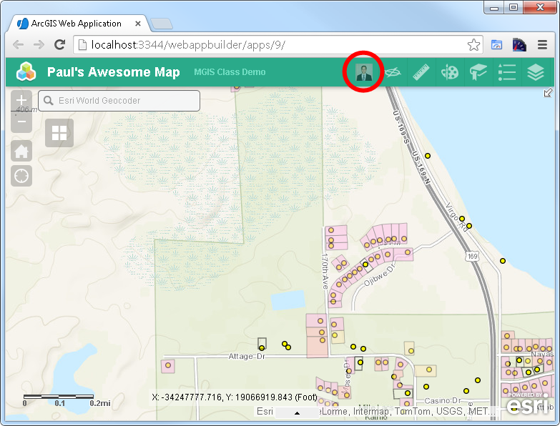
WAB – Custom Widget

Slide 56
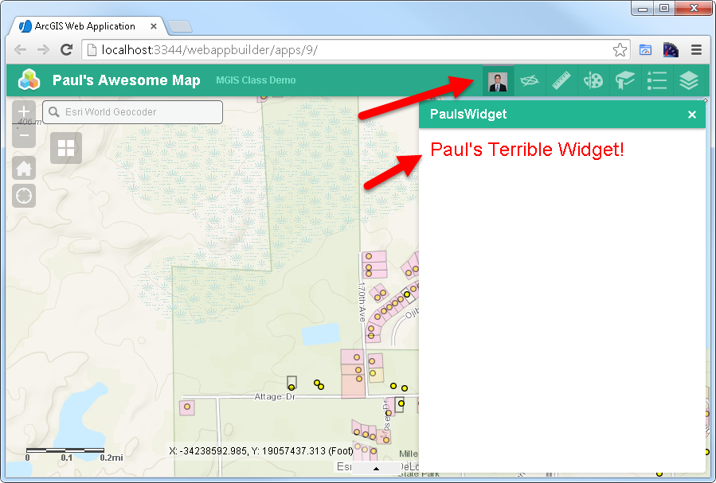
WAB – Custom Widget

Slide 57



WAB – Responsive Custom Widget

Slide 58

WAB – Themes
10 out of the box themes

Slide 59
Advanced Tools
Esri-wab-build (https://github.com/gbochenek/esri-wab-build)
Yeoman Framework (organize code)
Gulp/Grunt
TypeScript
LiveReload

Slide 60

Experience Builder
Next evolution of Web AppBuilder
A complete design and code re-write by ESRI
Built on top of 4.X JavaScript API. Also, uses React under the hood.

Slide 61
Experience Builder
Web App Builder = Mobile Friendly
Experience Builder = Mobile First

Slide 62

Experience Builder – Deployment Timeline

Slide 63

Experience Builder – What Does It Look Like?

Slide 64

Experience Builder – What Does It Look Like?

Slide 65
Useful Links
Documentation
http://developers.arcgis.com/web-appbuilder
GeoNet
https://geonet.esri.com/groups/web-app-builder-custom-widgets/content
https://geonet.esri.com/groups/web-appbuilder-custom-themes
Other WAB Resources
https://geonet.esri.com/blogs/myAlaskaGIS/2016/03/09/web-appbuilder-developer-edition-customization-resource-list
https://github.com/gavinr/web-appbuilder-tools-techniques-dev-summit-2018
https://github.com/Esri/generator-esri-appbuilder-js

Slide 66
WAB – Demos – What is Possible
https://egis.umn.edu/twincities/index.html
http://pm.maps.arcgis.com/apps/webappviewer/index.html?id=3eed8d6b30ea443dafe4380d70d0fa5e
http://gisapp.mahoningcountyoh.gov/Mahgis/
https://citymaps.bayswater.wa.gov.au/WABexternal/Census2016/index.html
https://whereto.sg/index.html
http://coolmaps.esri.com/dashboards/visionzero/

Slide 67
A few of the Widgets Developed By HEI
Go Anoka Park App – Advanced Custom Search and Custom Keyword Search
http://gis.anokacountymn.gov/GoAnoka/
Stearns County Park and Rec App - Advanced Custom Search and Custom Keyword Search
https://gis.co.stearns.mn.us/parks/index.html
Sales Tax Rate Map – Minnesota Department of Revenue
https://taxmaps.state.mn.us/salestax/
Others
Mailing Labels Widget
Custom Display Widget for Print (Isolate Widget)
Custom Selection Widget
More

Slide 68

Custom Widget – Time to Code…
https://github.com/paulhedlund/2018GISLIS

Slide 69
Thanks for Attending! Questions?

